Slide 1



WARWICK EWB X COLLINS AEROSPACE TRANSMISSION SHAFT STORAGE
Notes:
Good afternoon thank you for coming to the presentation and we will be starting our presentation now. We will be presenting our ideas and concepts designs for the storgage transmission system

Slide 2
Initial Problem
The Problem
Transmission shafts storage
Shafts damaged in storage
Monetary loss from damaged shafts
Our Task
No contact solution
Modular design
Transporting transmission shafts
Notes:
Also put pictures
( Devvan )
We created an initial problem task based on the design specification provided by Collins Aerospace. We identified the following issues:
Transmission shafts used later on in the production line are stored after manufacture until they are needed.
Due to the lack of a proper storage system on the line and in quality clinic areas, shafts can get scratched, dented, and gain other imperfections that could lead them to fail the visual acceptance standard.
The damage to these shafts lead to monetary losses as these shafts cannot be used
Given these issues, we planned to implement a solution which aimed to:
To provide design solutions for shaft storage where shafts do not contact each other
Design solution is encouraged to be modular due to the large number of transmission shafts that are produced
Consider transport of shafts to the designed storage solution to prevent damage to the shafts

Slide 3
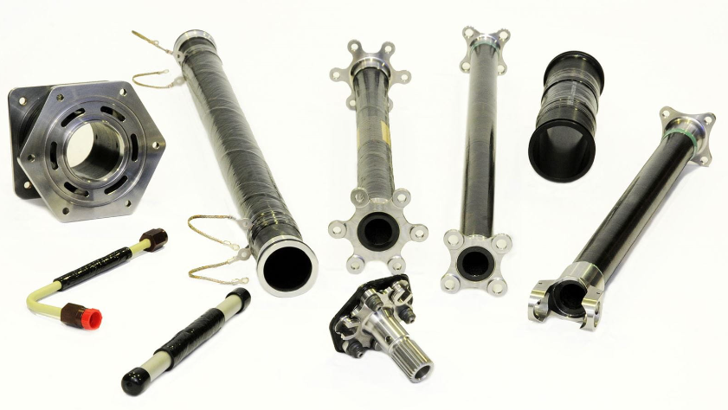
Background Information
Shafts are made from composites
Shafts can be designed with numerous end fittings, allowing a variety of configurations, for example: flanged end fitting, yoke end, fixed and free spined, steady bearing, torque disc tripod, metallic shaft.
Vary in length from 30cm - 2m length
Vary in diameter from 20mm – 50mm
Notes:
Need to add stuff here
There is a lot of info in the project chartered if u need it
Pictures as well ?
We did some initial research on the transmission shafts produced by Collins Aerospace. The shafts have a variety of configurations – in particular different shaped ends which need to be taken into consideration. We also had to take into account the varying lengths and diameters of the produced transmission shafts.

Slide 4
Week 1
Week 3
Week 2
Week 4
Briefing
Concept Designs
Project Charter
Concept Designs
Notes:
Gagandeep
Timeline Process
Bullet point it pls
[ this is our timeline ]

Slide 5
Week 5
Week 7
Week 6
Week 8
Briefing
Site Visit
Teams Call
Design changes
Notes:
Gagandeep
Read Bullet points pls

Slide 6
PROJECT STAGES
Stage 3
Stage 2
Stage 1
TESTING
IMPLEMENTATION
PLANNING
Notes:
Gagandeep
Talk about planning implementation and testing (Un)

Slide 7
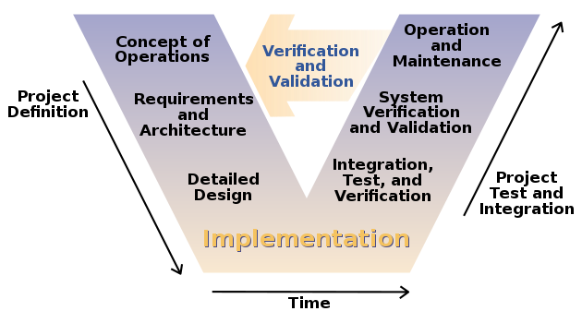
The V-MODEL
Notes:
Devvan
The V model is a graphical representation of the development process for a design. It ensures that a sequential and well-structured procedure is followed throughout the project. We split the project up by looking at what was expected from Collins Aerospace, what we wanted to implement into our final design, drawing up concepts which we can assess against our criteria, implementation of the design within the scope of the project and testing and verification of the final design which we have not yet been able to do.

Slide 8
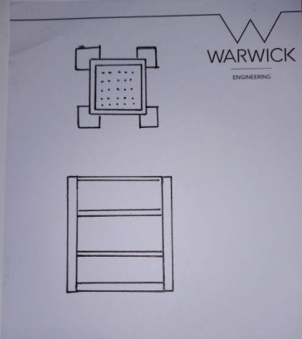
Intermediate Storage System Concept design
Notes:
Ethan
A design for the intemediate storage of the transmission shafts where they can be stored inbetween manufacturing and testing. This was designed after our site visit where we spoke to workers.

Slide 9
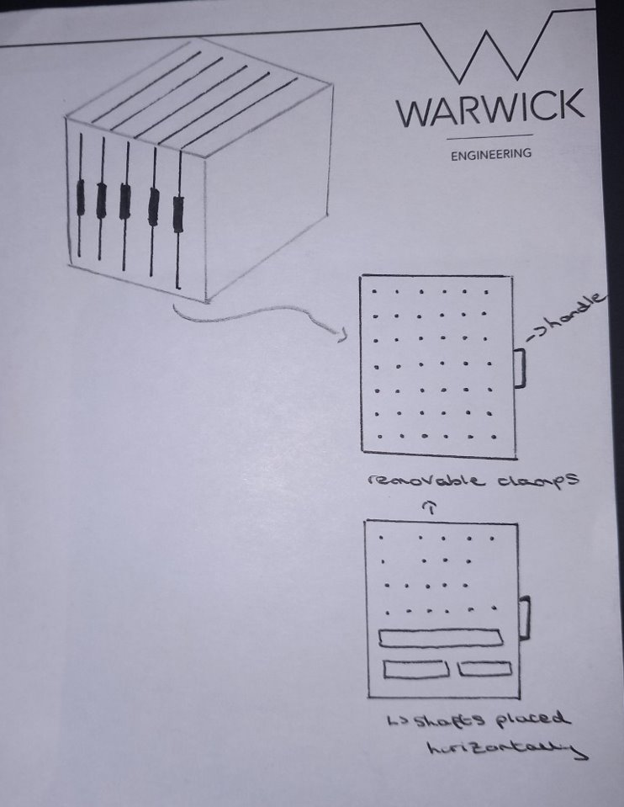
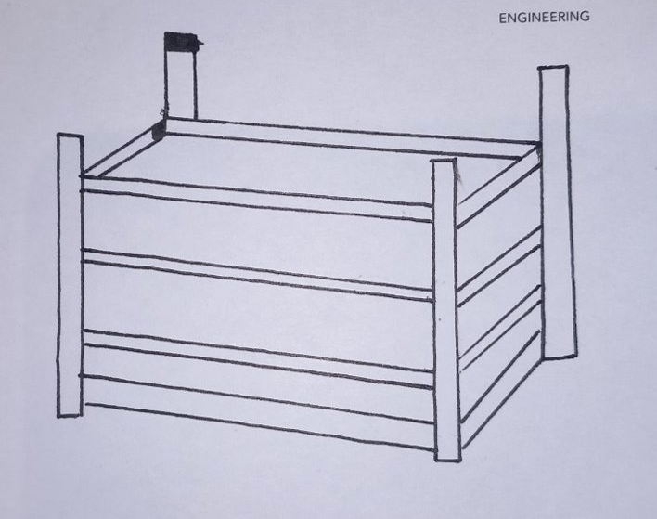
Final Storage System Concept design
Concept 1
Concept 2
Notes:
Ethan
First – simple shelf system with potential pockts to place shafts into, not space efficient
Second – in the form of a cupoboard with vertical storage drawers, with each drawer having slots for clamps to fill the wall. These clamps were to be removable and spaced as such to fit the mutltitute of transmission shafts

Slide 10
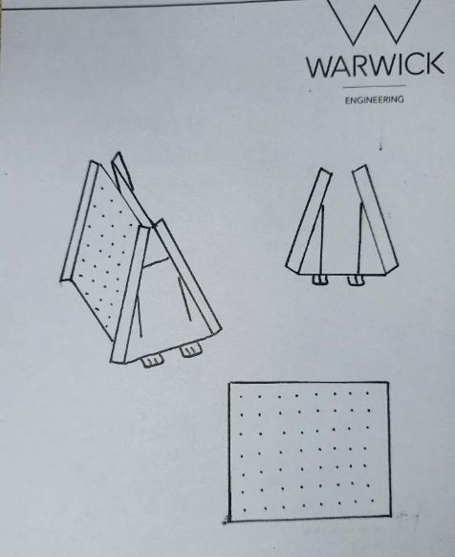
Trolley Concept design
Notes:
Designed after visit – redcisgen trolley system
Same clamp system as the vertical storage drawers with removable clamps

Slide 11
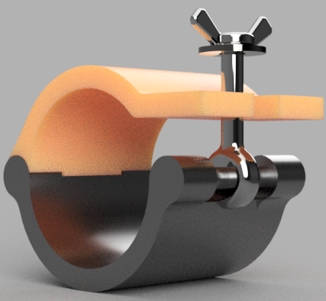
Clamp Concept design
Stopper to constrain the shaft inside the clamp
Threaded to tighten the stopper to secure the shaft
Axis around which the stopper rotates to allow shaft storage.
Notes:
Arjun: This is render of our initial clamp concept design. The main body of the clamp would be made using ABS, ideally injection moulded for large scale manufacturing. It consists of a stopper with a threaded rod that rotates around an axis, to secure the transmission shaft safely.

Slide 12
PUGH MATRIX
Legend
Weighting: 1-5
Criterial: 0 or 1
Criteria | Weighting | Design 1 | Design 2
Modular | 4 | 1 | 1
Shaft Accessibility | 2 | 0 | 1
Capacity | 3 | 0 | 1
Efficiency | 3 | 0 | 1
Design Simplicity | 3 | 1 | 1
Notes:
Arjun : The Pugh Matrix is a simple yet effective tool we used to make our design choice. We started by simply listing the design options and the important criteria affecting our decision. We then evaluated each option against each factor, giving each a score 1. The option with the highest overall score is the better choice and in our case it was Design 2 which was a vertical trolley in which the shafts were stored horizontally. The Pugh Matrix not only helped us weigh the pros and cons of each option, but also provided a clear, visual representation of our decision-making process.

Slide 13
Teams meeting and adjustments
Points discussed in teams meeting:
Current process of transporting shafts
Production rate
Manual process to store shafts.
Specific considerations
Dust and debris
Intermediate trolley system
Pipe lengths
Changes made after meeting :
Foam cut out consideration
Modular design to fit production numbers
Edges lined with foam
Rod inclination to reduce dust collection
Shaft lengths considerations for all sizes
Notes:
Devvan
We had a teams meeting in early November with Simon from Collins Aerospace. In this we were able to find out more about the project as the scope for which we were able to clear up some misconceptions and understand the project with more clarity
Current process of moving and storing rods is through a trolley system and foam cut out semicircles to squeeze and hold shafts.
Manufacture 100 shafts made a day
Sharp edges need to be avoided for the design
Collection of dust and debris at the bottom of the tubes when vertically stored
The requirement of an intermediate trolley system to transport the shafts
Lengths of pipe vary from 0.5m up to 2m and the varying diameters
Changes:
Worked toward designing an efficient foam cut out
Scaled unit sizes so they are modular to accommodate the number of transmission shafts produced in a day
Consideration to avoid sharp edges – line with foam
Rods to be inclined at an angle to avoid dust collection – have some clearance from the floor
Design a system to accommodate all shaft lengths as there are some pipes as long as 2m

Slide 14
VISIT TO COLLINS
Site visit to Collins Aerospace
Shown around the factory
Able to see the area in which our design had to be suitable for
Talked to those who handle the shafts on a day-to-day basis to understand the needs of our customer
Made significant changes to our design
Changes made after visit :
Began creating new designs for the clamps as the issues surrounding security of clamps had not been established prior
Started a design for a trolley to transport the shafts to the storage system
Notes:
Arjun: On 30th November, we were shown around the factory, and were walked thru the whole manufacturing process of the transmission shaft. We were able to asses the area in which we had to seamlessly accommodate our storage system. Additionally we also had an opportunity to talk to those who handle the shafts on a daily basis which really helped us understand the needs of our customer. The increased input from the customer helped us make better design choices to fit the requirements.

Slide 15
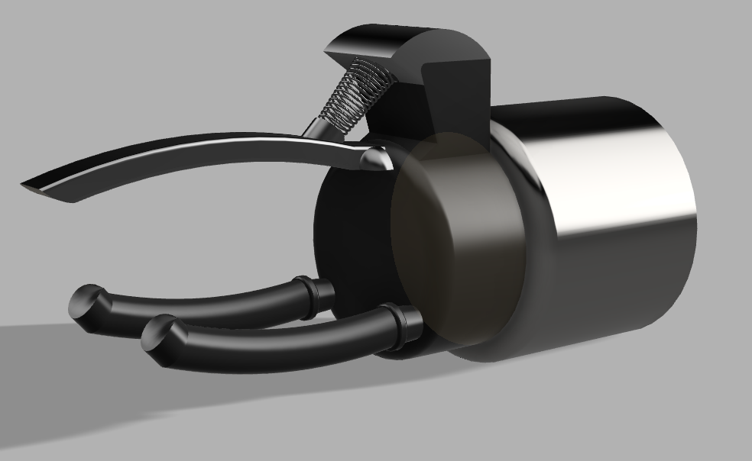
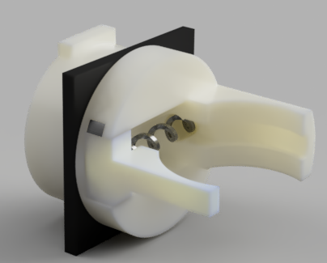
Final Clamp Design
Design 1
Design 2
Notes:
Ruben / Gagandeep
Rubber- grip
Strong Sping Based mechanism to allow for variance in shaft diameter
Auto-locking – Horizontal Placement

Slide 16
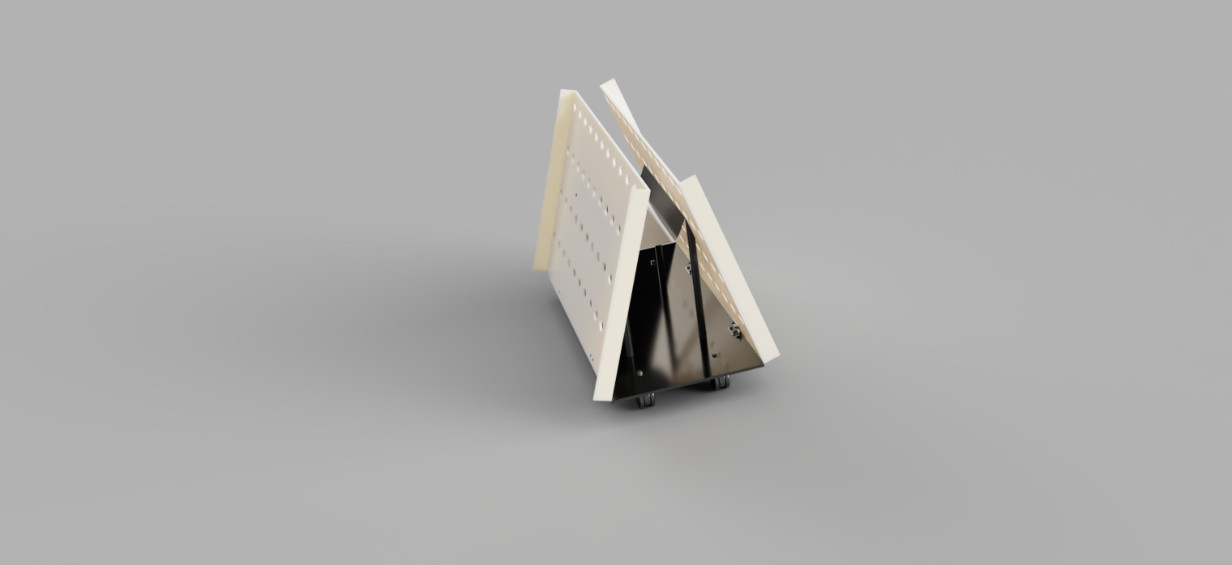
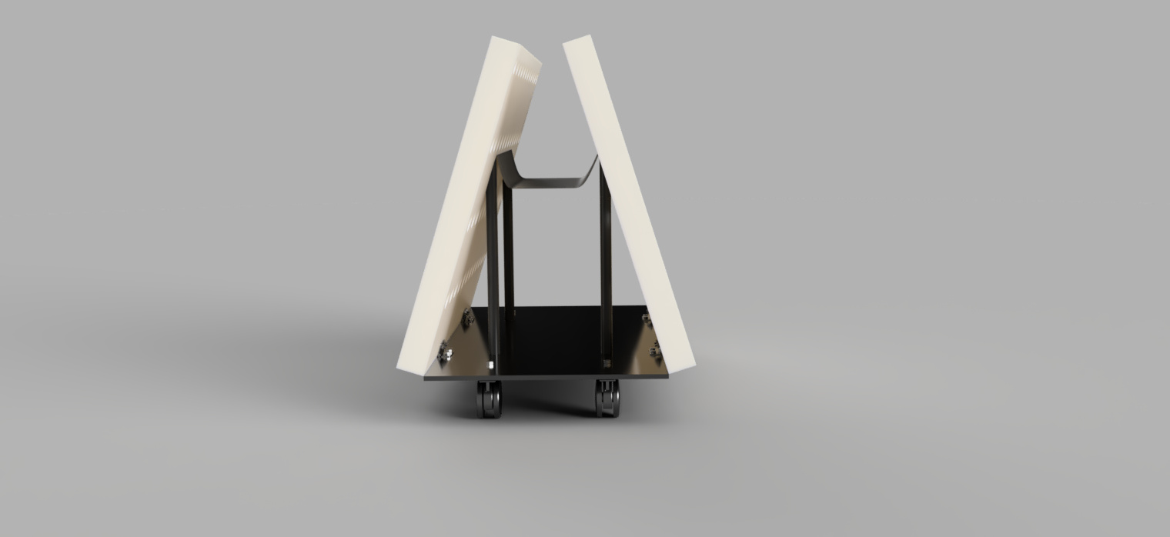
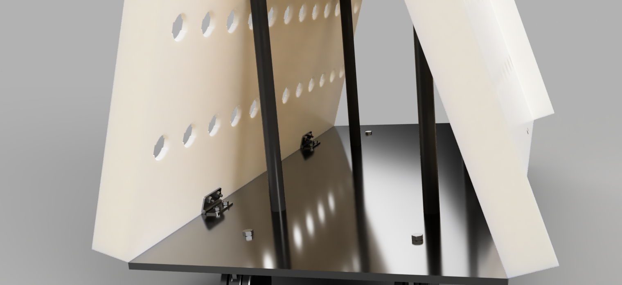
Final Trolley design
Notes:
Ruben
https://circuitdigest.com/tutorial/butterworth-filters-first-order-and-second-order-low-pass-butterworth-filters
For second order - The gain of the second-order filter is set by R1 and RF, while the cutoff frequency f_{H} is determined by R₂, R₃, C₂ & C₃ values. The derivation for the cutoff frequency is given as follows,?
https://www.youtube.com/watch?v=lc6QT8VjqVc watch this and make notes and sayt that

Slide 17


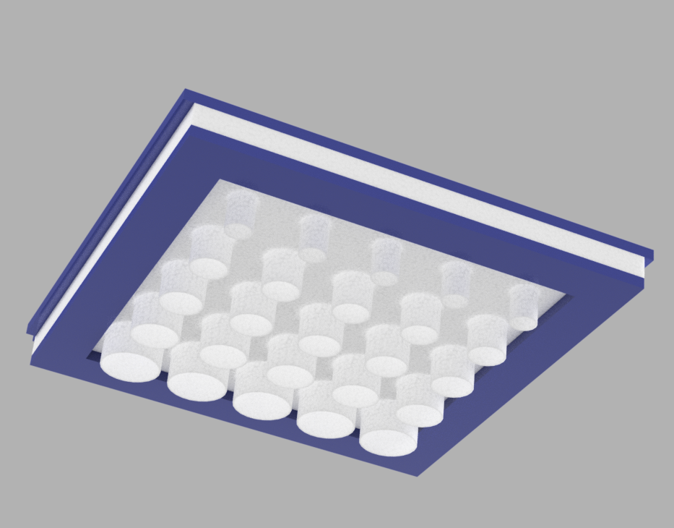
Intermediate storage system final design
Height – 85cm to make it easy to put in tall shafts but longer than current system in place to prevent collisions with other shafts.
Accommodates all lengths of shafts with varying diameters
Furthermore, top layer off material has 5cm extended tubes to prevent the longer shafts from colliding and preventing damage
Designed to be small, lightweight, modular and easy to access.
Layers of foam can be customised with ratio of hole diameters to meet needs and they can easily be taken out and replaced due to the open front-end design
Figure 3
Figure 1
Figure 2
Notes:
Pradyot

Slide 18
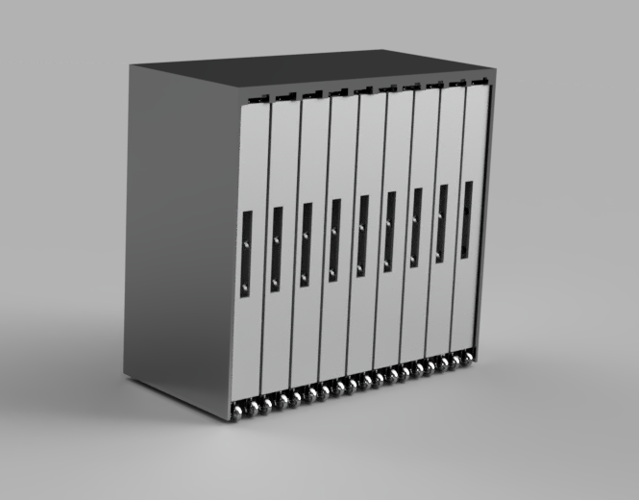
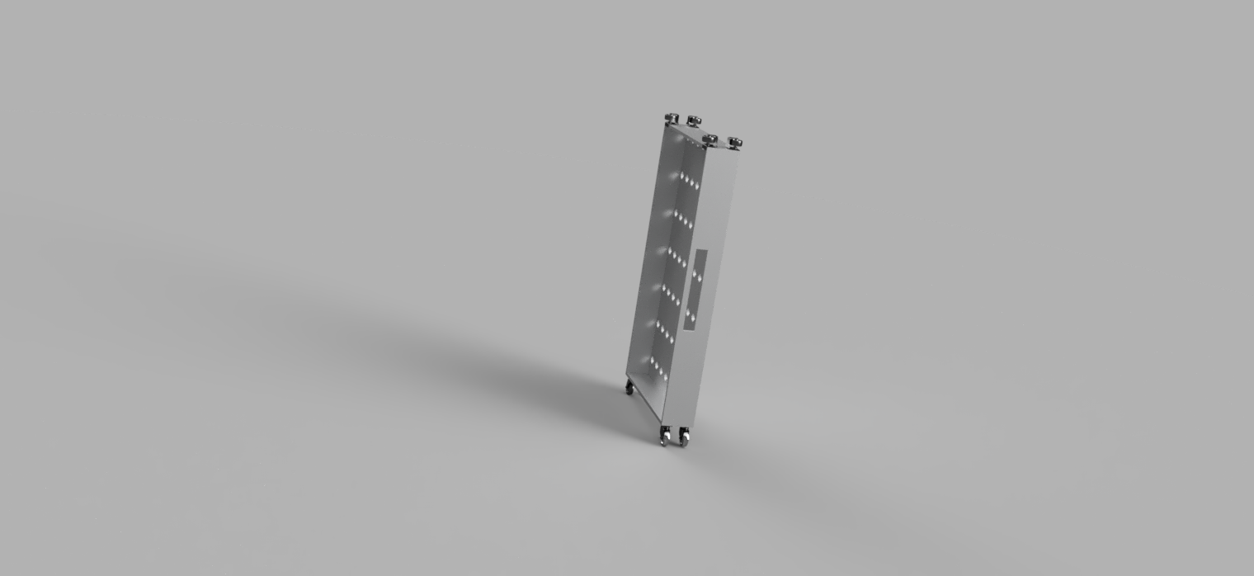


Final storage system design
Notes:
Rueben

Slide 19
Material selection and manufacturing
ABS – Clamp and can be made using injection molding
Rubber grips to prevent metal on metal contact and provide grip
Spring/elastic can be
bought externally or manufactured in house
Aluminum for main structure of the storage system, as it is light. This can be shaped using a CNC machine, which creates the slots for the clamp to clip into.
The yokes for wheels should use a thinner type of metal. To form yoke shapes and circular grooves, achieved by running the thin metal sheets on a punch press.
Rubber used for wheels using nylon wheel inserts and place them injection mold, cool and then smooth out edges.
Aluminium or steel casing to prevent damage, it is hardwearing .
Using very little machining to reduce waste and have a sustainable manufacturing process.
Notes:
pradyot

Slide 20

Material selection and manufacturing
Polyurethane used to line sharp edges of any design. It is light and cheap. It can be coloured brightly to make it more visible to make hazard more visible.
Felt sheet draped in between to hold additional clamps when not in use. It is cheap and soft and will prevent damage to clamps. Can be easily cut into the right size.
Using Polypropylene for the main body and structure of intermediate storage system and can be manufactured using injection moulding which is cost effective and efficient with very little waste
Simple brake pads used to hold trolley stationary. Made from plastic lined with a thin layer of rubber
Aluminum sheet metal used for main structure of trolly. It is light weight durable and easy to manufacture. This can be done through CNC machine
Polyethylene to protect transmission shafts when being held in area before moving onto next manufacturing stage (addition of end fittings) . Can be easily cut, shaped and stuck together. It is light weight, durable and cost efficient.
Screws to join wheels and separate sections to main body. M10, M12
Notes:
Pradyot
Intermediate storage system

Slide 21
REFLECTION
Highlights of our success
Good design Concept
Project Management skills
Passion
Improvement
Communication
Earlier site visit
Prototype and Testing
Notes:
Arjun: On completion pf this project this is a collection of our thoughts as part of a team reflection.

Slide 22
Thank You For Listening Any Questions?

